Slide 1
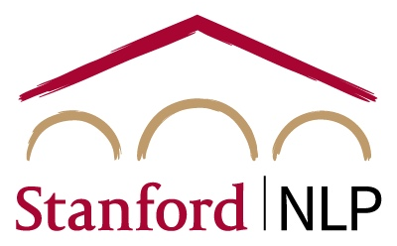
Dynamic Aggregation and Auto-Discovery of Linguistic Features
Yanchen Liu

Slide 2
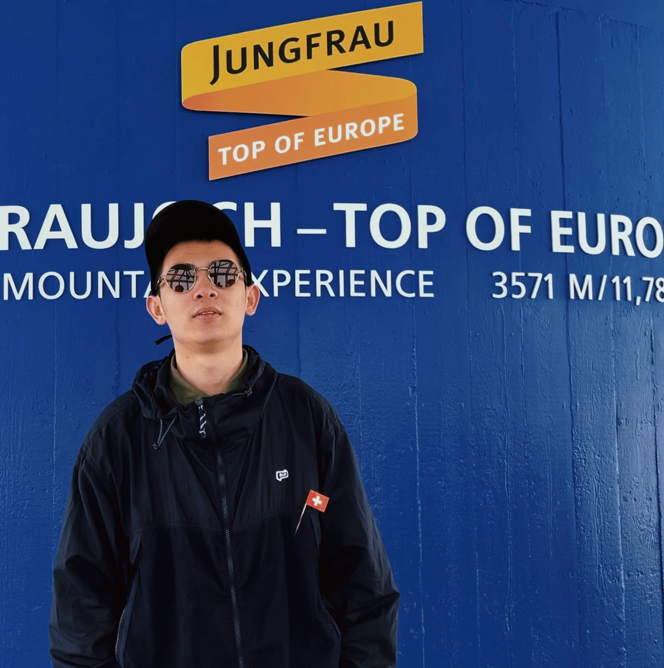

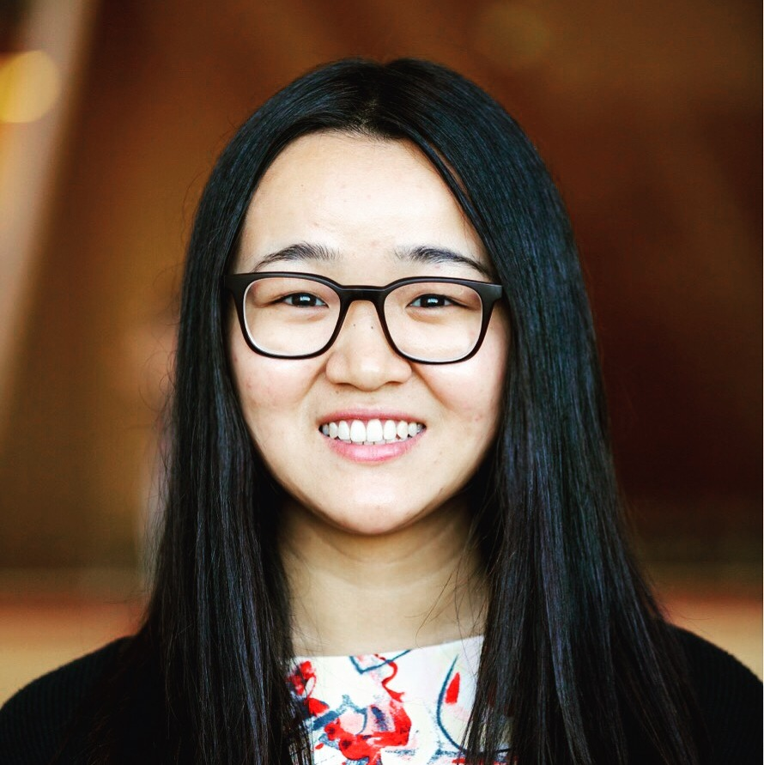
DADA: Dialect Adaptation via Dynamic Aggregation of Linguistic Rules
Yanchen Liu, William Held, Diyi Yang
will appear on EMNLP 2023

Slide 3
Non-Standard Linguistic Features
language usage that deviates from the conventions
often associated with specific social or cultural groups
Example: Negative Concord
He wonʼt do Ø harm.
▼
He wonʼt do no harm.
Dialect: A Group of Non-Standard Linguistic Variations in a Language
🤔️ Do these sentences mean the same thing?

Slide 4
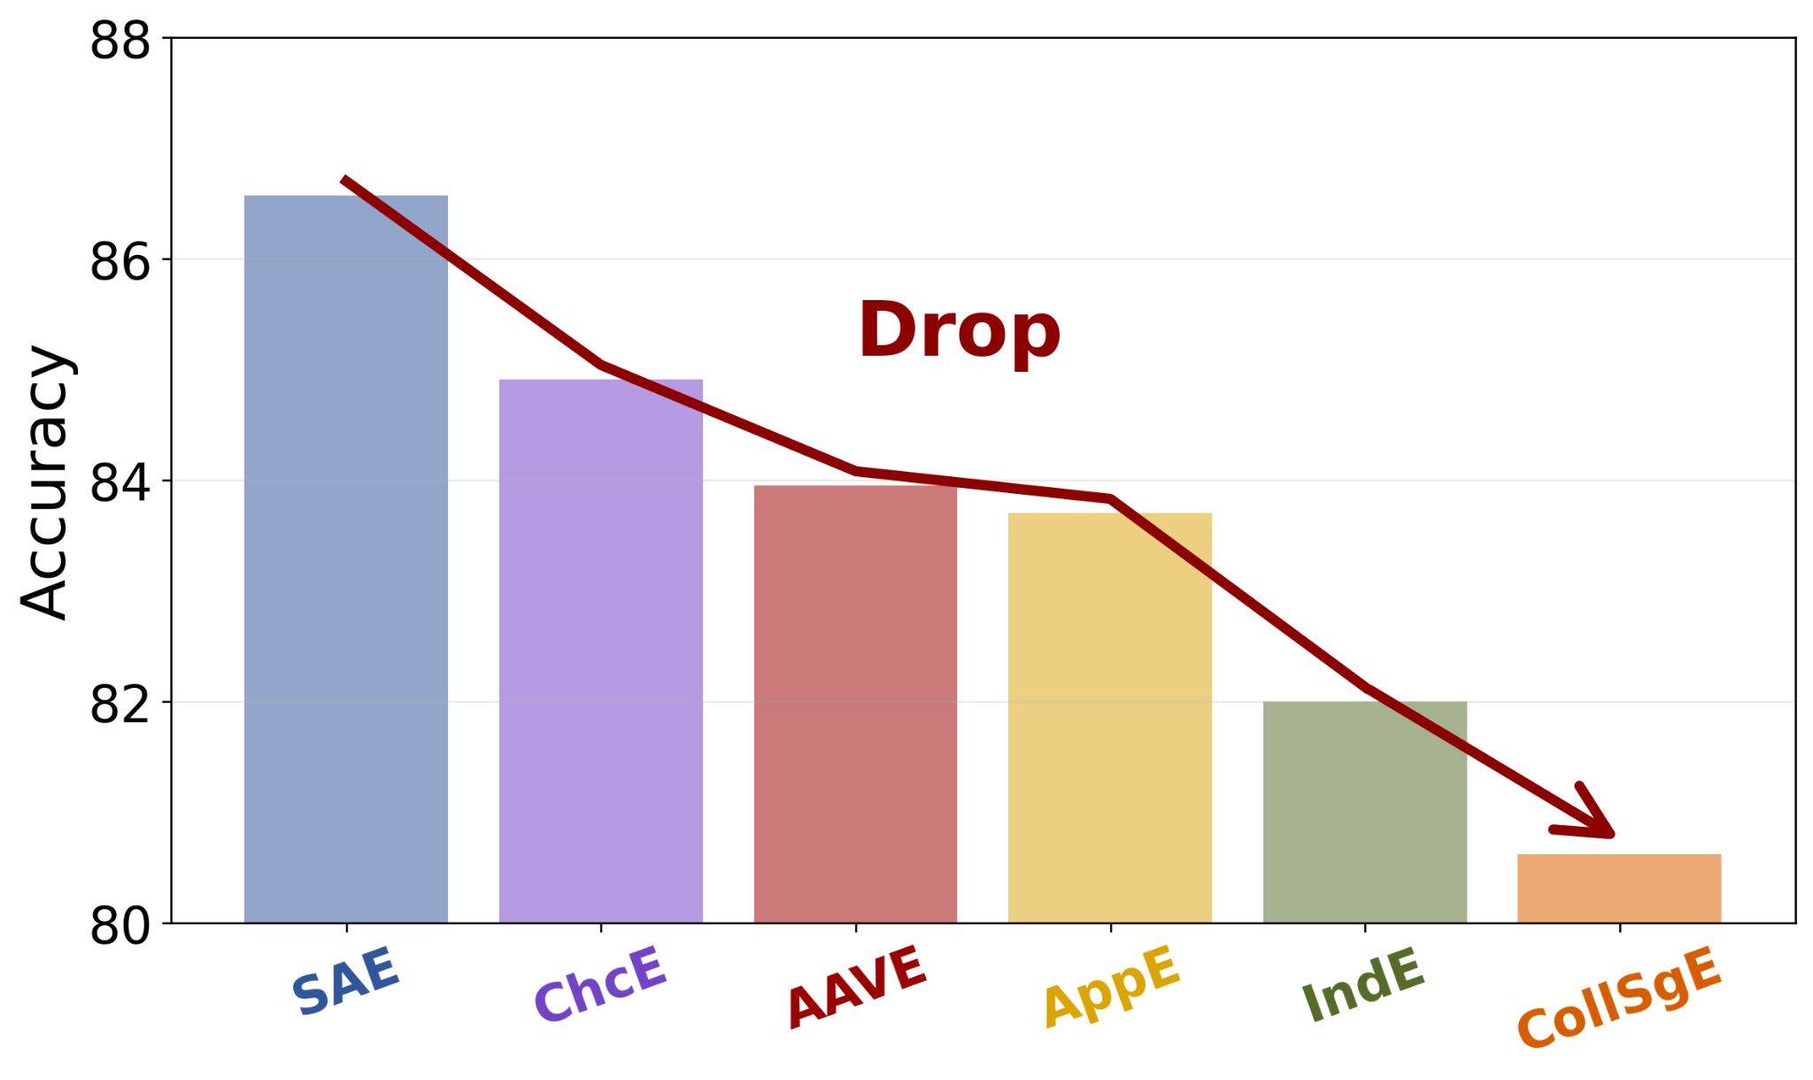
Fails on Dialects
Existing models mainly focus on Standard American English (SAE)
Significant performance drop↓when applied to English Dialects

Slide 5
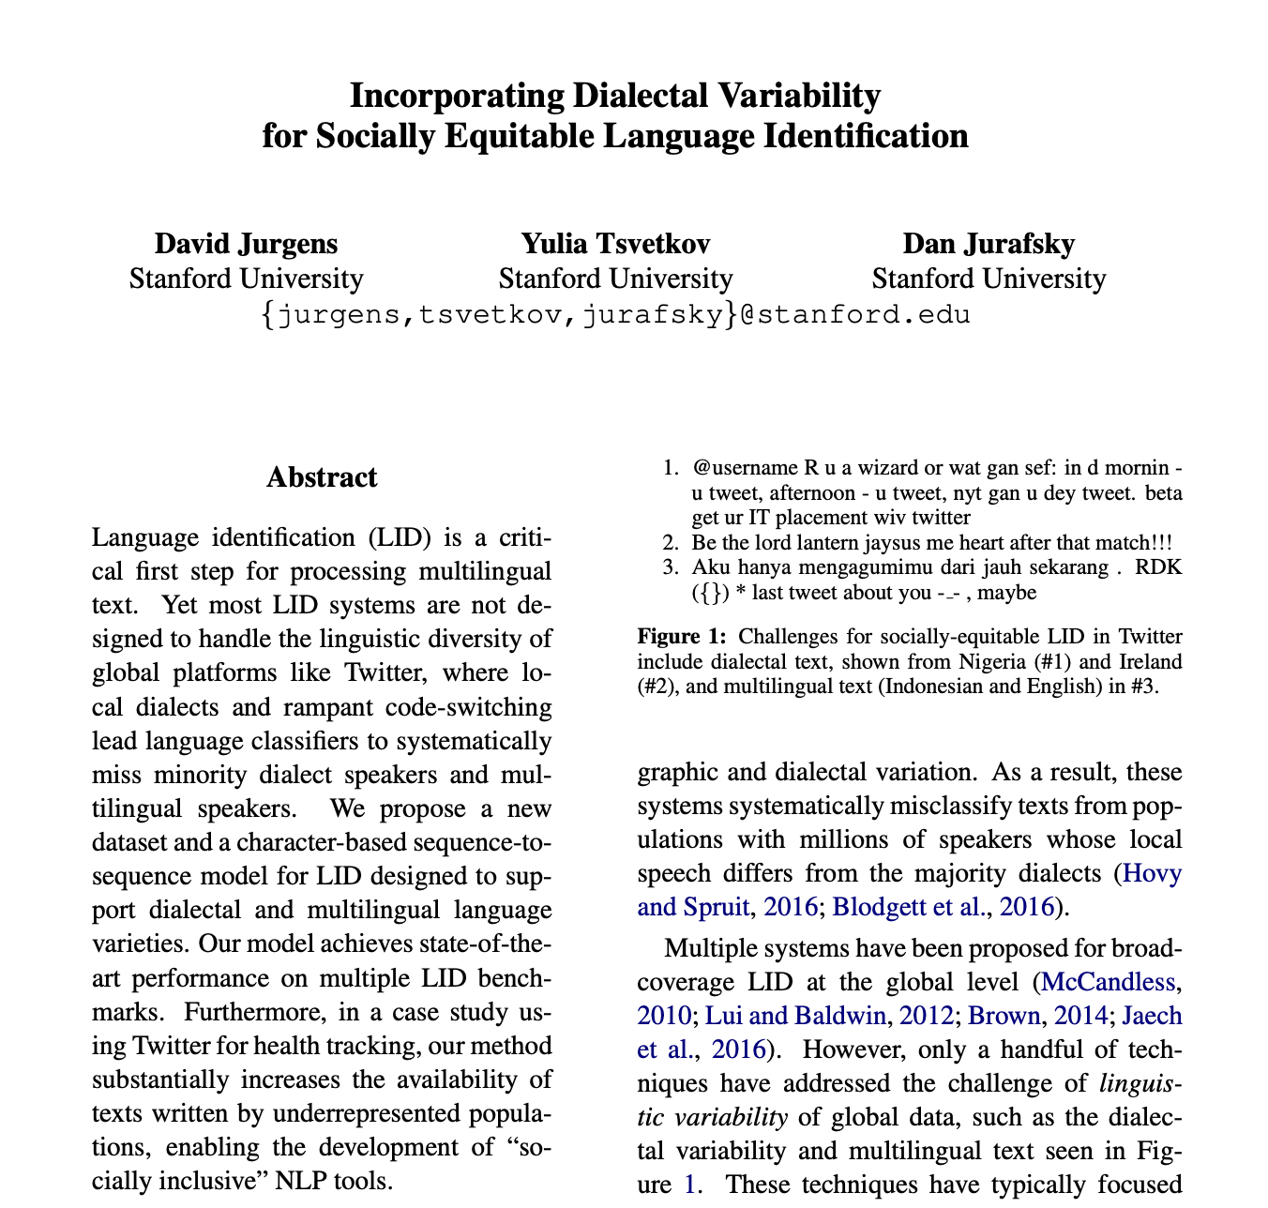
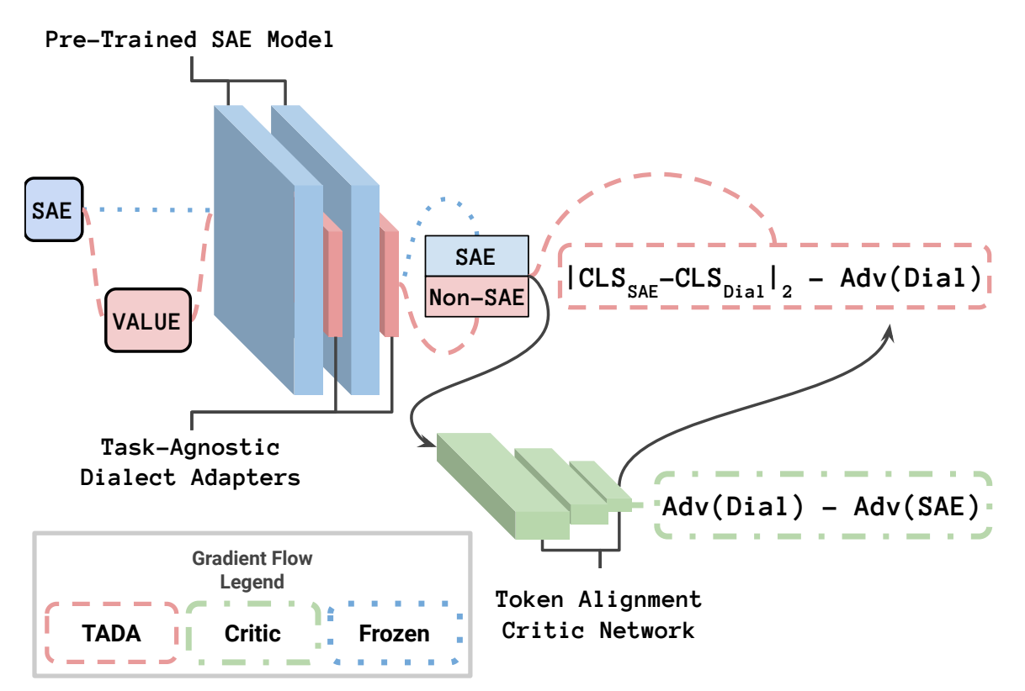
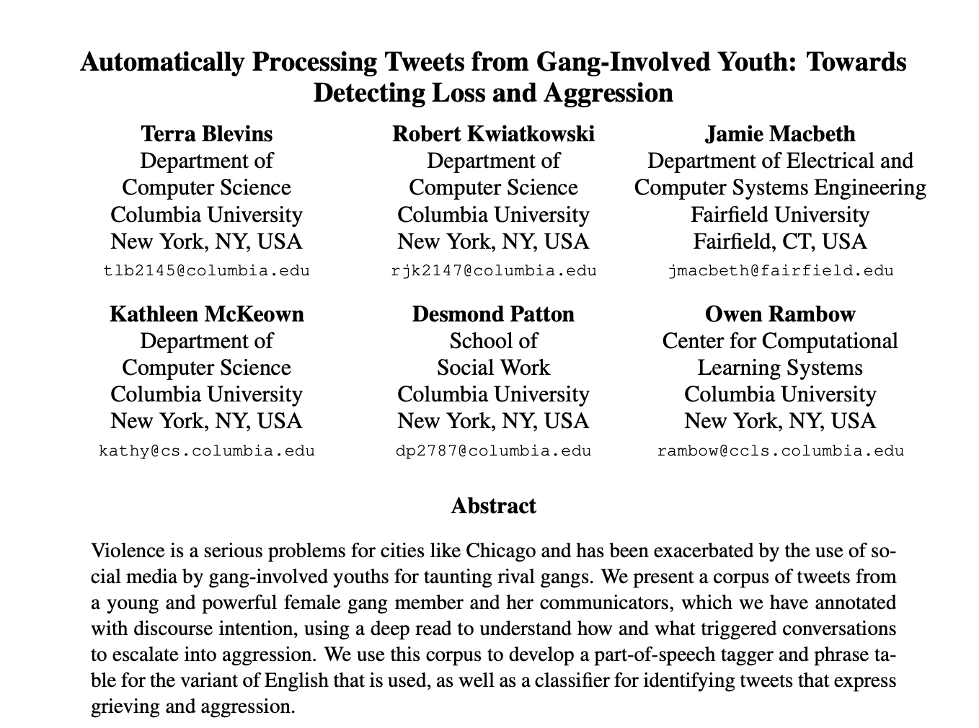
Previous Work on Dialect Adaptation
Mainly focused on targeted adaptation to a specific dialect
Human Annotation (Blevins et al., 2016, Blodgett et al., 2018)
Weak Supervision (Jorgensen et al. 2016, Jurgens et al. 2017)
Alignment (TADA 2023)
⚠️ Highly accurate dialect identification systems are required!

Slide 6
However!!! Inherent Flexibility of Dialects
Flexible Boundaries
=> no highly accurate dialect identification systems available
Vary Depending on Personal and Social Contexts
=> dialects do not neatly fit into predefined categories
🌟 Accommodate the diversity of dialects from a Fine-Grained perspective Linguistic Features

Slide 7
Method

Slide 8
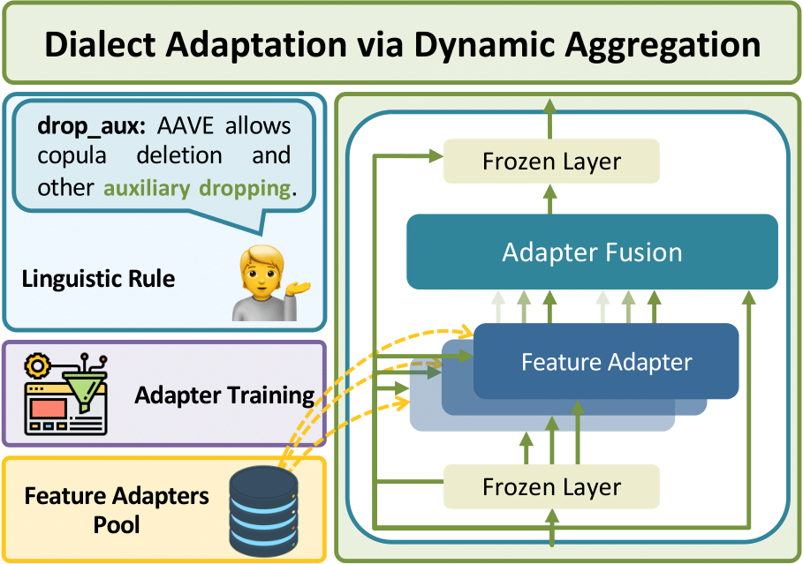
Dialect Adaptation via Dynamic Aggregation
Multi-Dialectal Robustness
Input Dialect-Agnostic
Personal- and Social-Contextual
🏅️ Modular and Dynamic
🌟 Within Only 3 Steps
Synthetic Datasets Construction
Feature Adapter Training
Dynamic Aggregation

Slide 9
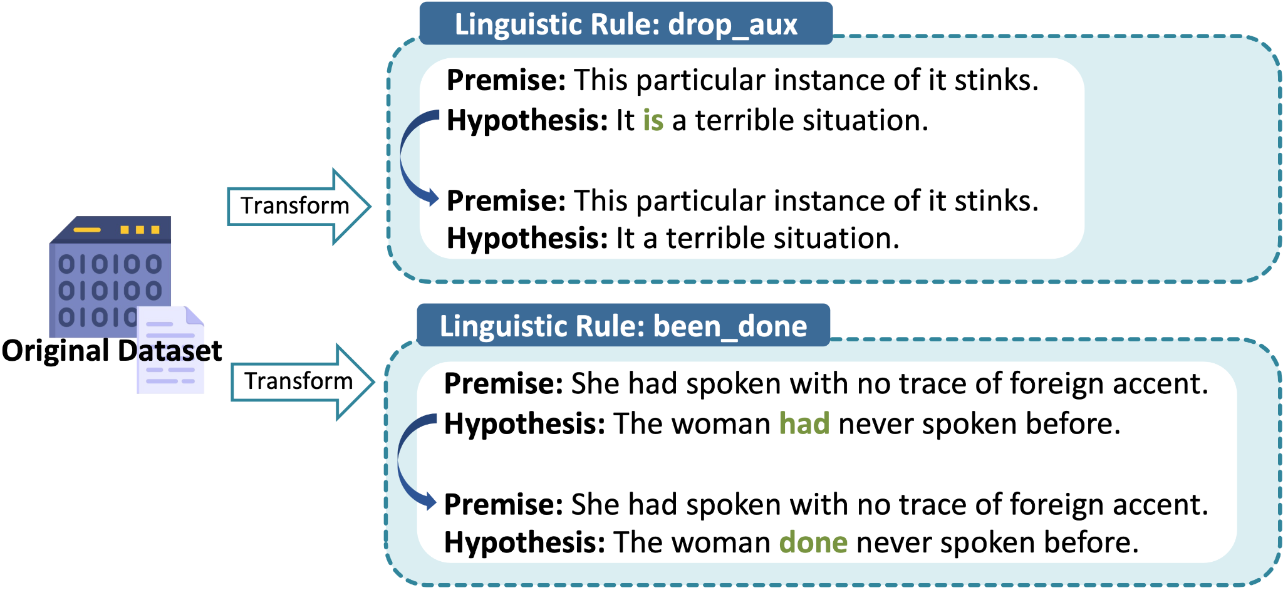
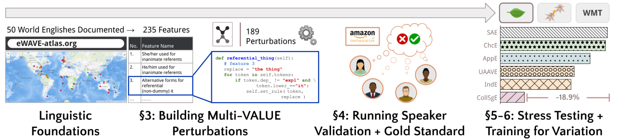
Step 1: Synthetic Datasets Construction
🔖 Construct a transformed dataset for each non-standard (morphosyntactic) linguistic feature.
[2] Ziems et al. 2022. Multi-VALUE: Evaluating Cross-dialectal NLP. ACL 2023.

Slide 10

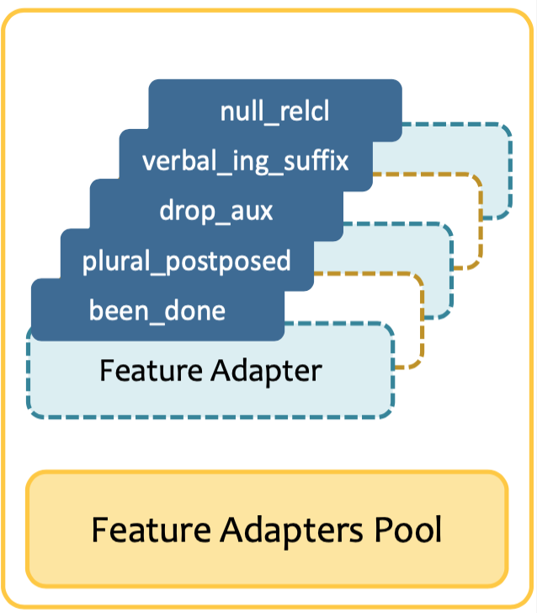
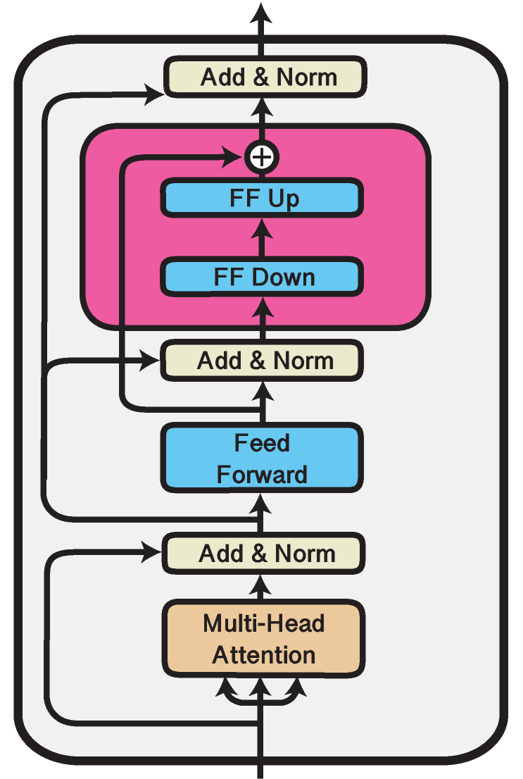
Step 2: Feature Adapter Training
Train a feature adapter for each non-standard linguistic feature.

Slide 11
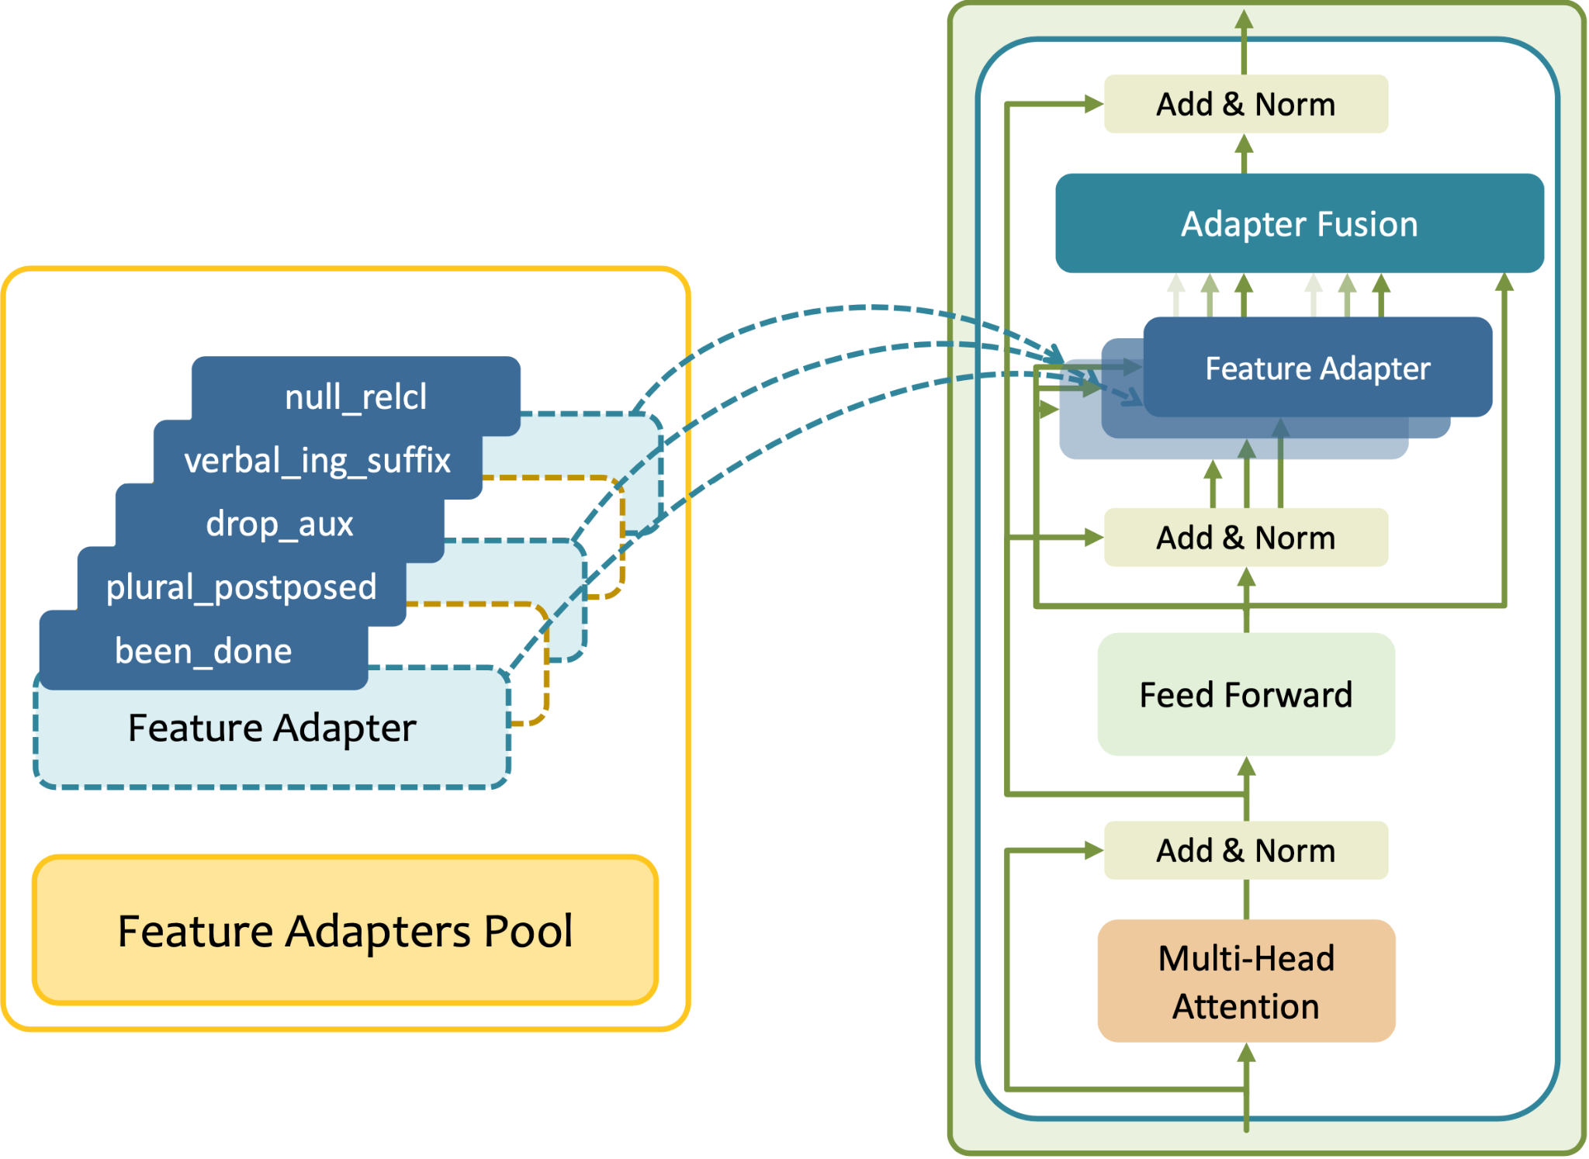
Step 3: Dynamic Aggregation
🔖 Aggregate & activate feature adapters dynamically.

Slide 12
Experiments

Slide 13
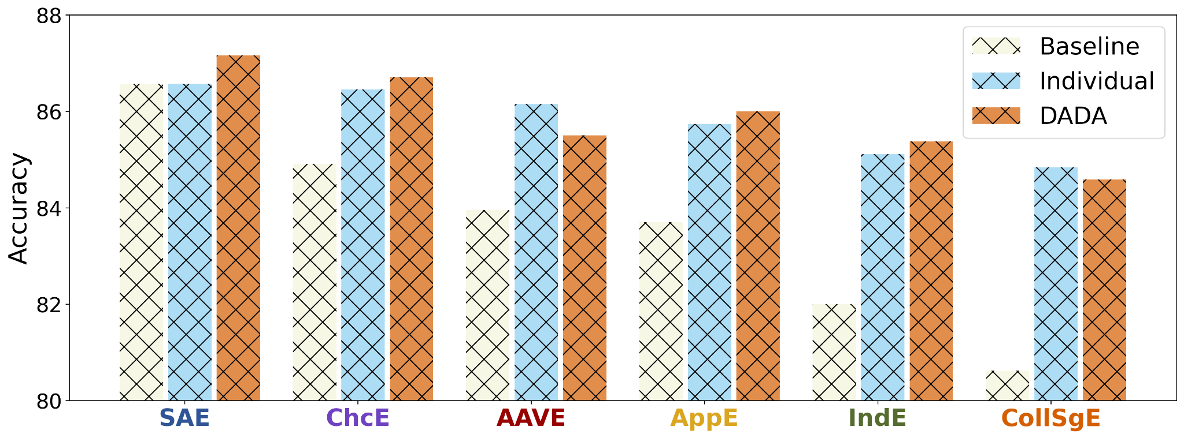
1/ DADA Can Improve Multi-Dialectal Robustness
Adapt SAE model to multiple dialect variants simultaneously: AppE, ChcE, CollSgE, IndE, AAVE

Slide 14
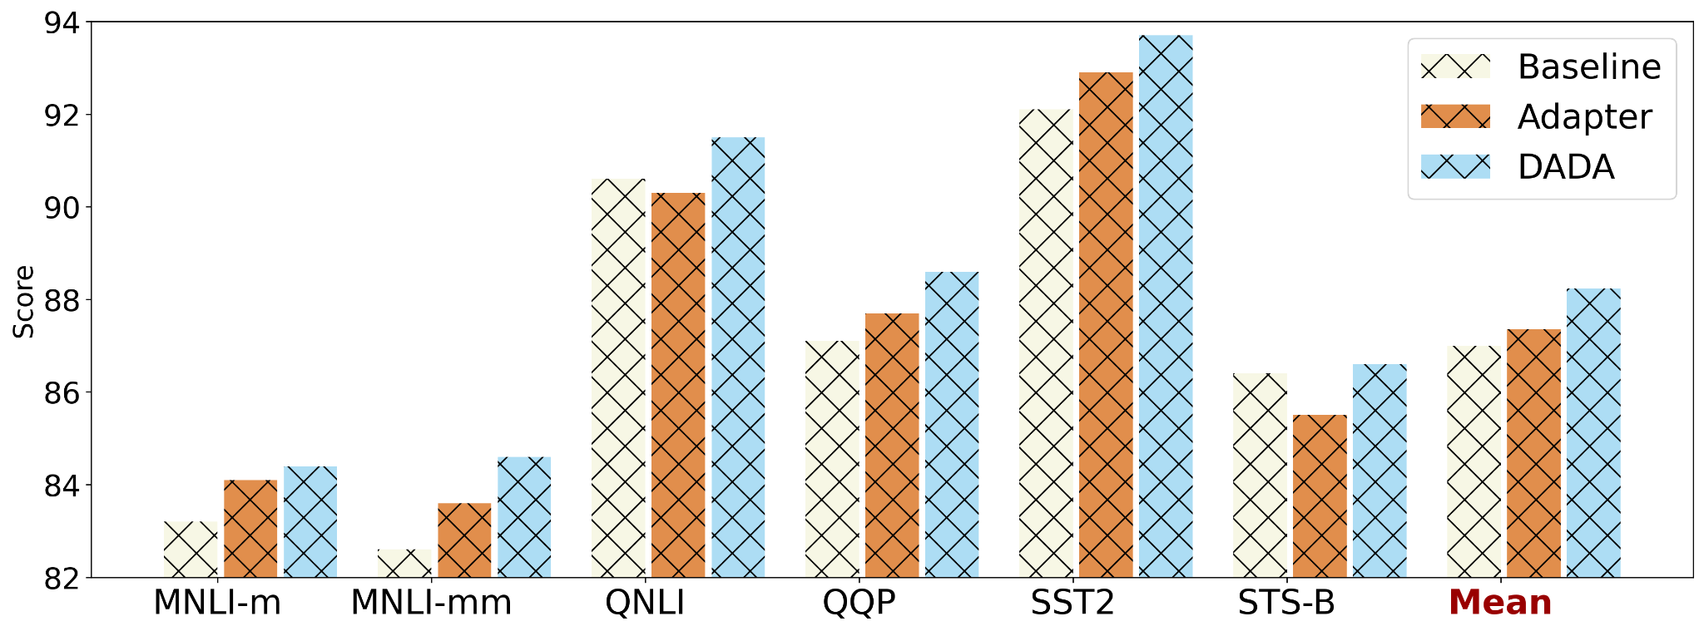
2/ DADA Can Be Task-Agnostic
Adapt instruction-tuned SAE model to the dialect variants for multiple tasks

Slide 15
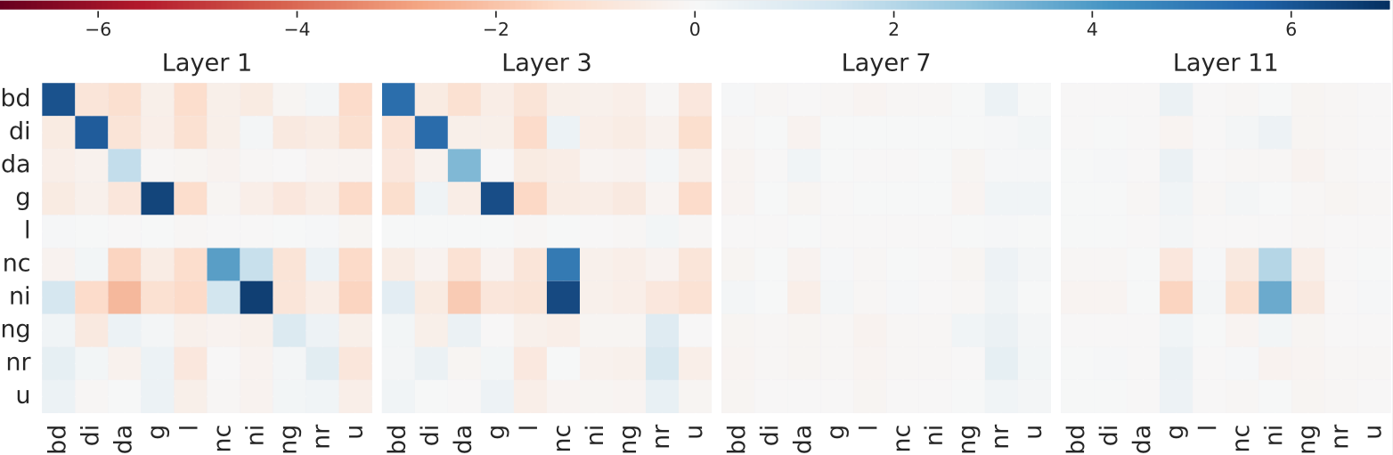
3/ DADA Has Great Interpretability!
Correlation Coefficients for AAVE Adaptation
We use abbreviations for certain terms, such as "nc" for "negative concord."

Slide 16
Conclusion and Future Work

Slide 17
Dynamic Aggregation of Linguistic Features
A Fine-grained and Modular Method for Dialect Adaptation
Improve Multi-Dialect and Multi-Task Robustness
No need for highly accurate dialect identification systems
Taking personal and social context into account
Applicable to task-agnostic instruction-tuned LLMs
Interpretability, reusability and extensibility

Slide 18

But!!!
Non-Standard Linguistic Features
are curated by linguists (eWAVE) and
play a crucial role in a wide range of applications.
However, the manual curation of linguistic rules can be expensive and expertise-intensive.
Empower Linguistic Research with LLMs
Large Language Models Can Discover Linguistic Features
(ongoing)
Mary Williamson

Slide 19
Introduction
Leverage LLMs to help:
Verify and Identify non-standard linguistic features
given a corpus, identify the non-standard linguistic features
current scope:
235 non-standard (morphosyntactic) English linguistic features from eWAVE
more in the future:
lexical, stylistic, etc.
more languages
Discover new linguistic features/usages
or new usages
e.g. I am shopping (at) Walmart
🌟 Linguistic Feature Discovery
He wonʼt do no harm.
Negative Concord

Slide 20
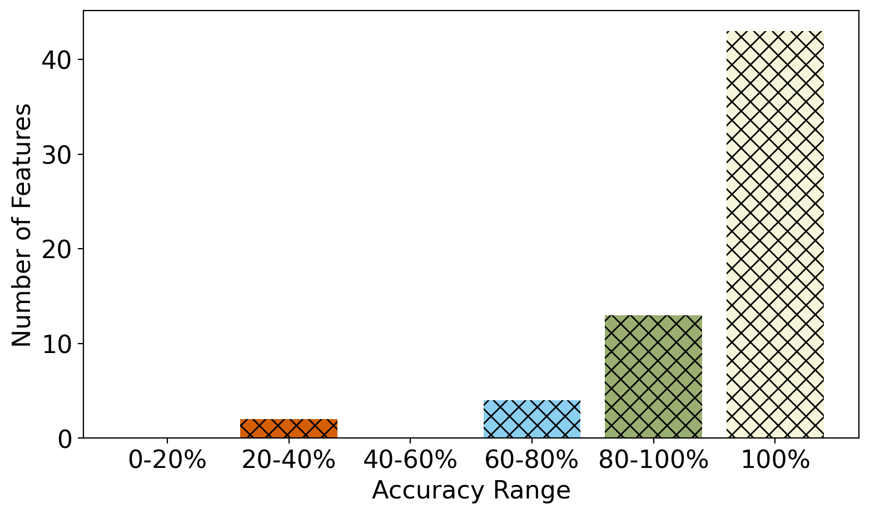
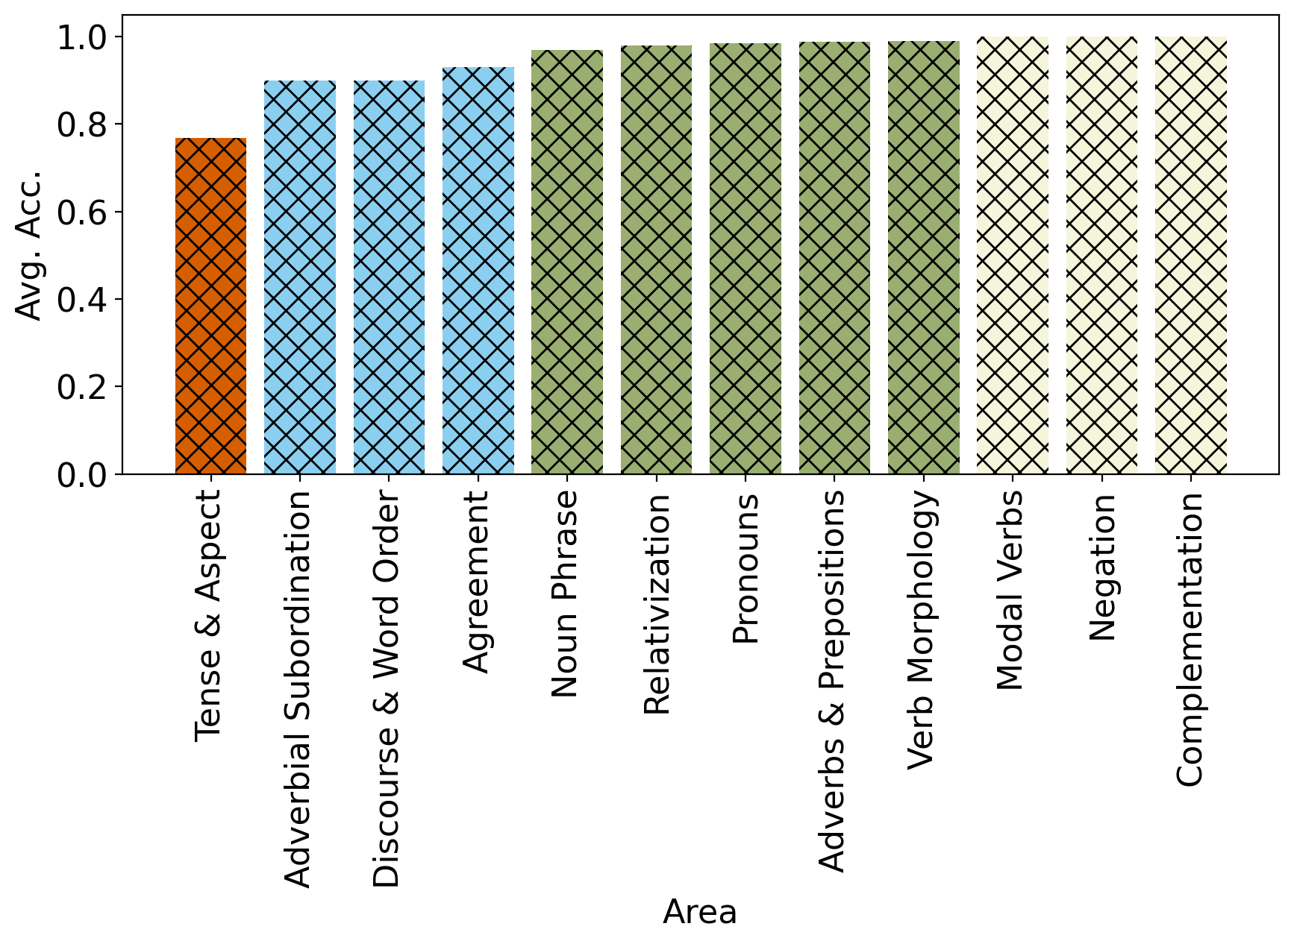
1/ Multiple Choice
Setup1: ask LLM to identify one single linguistic feature at a time
provide LLM a (synthetic) paragraph with a single linguistic feature, along with 5 choices
🌟 Different Difficulties For Different Feature Areas

Slide 21
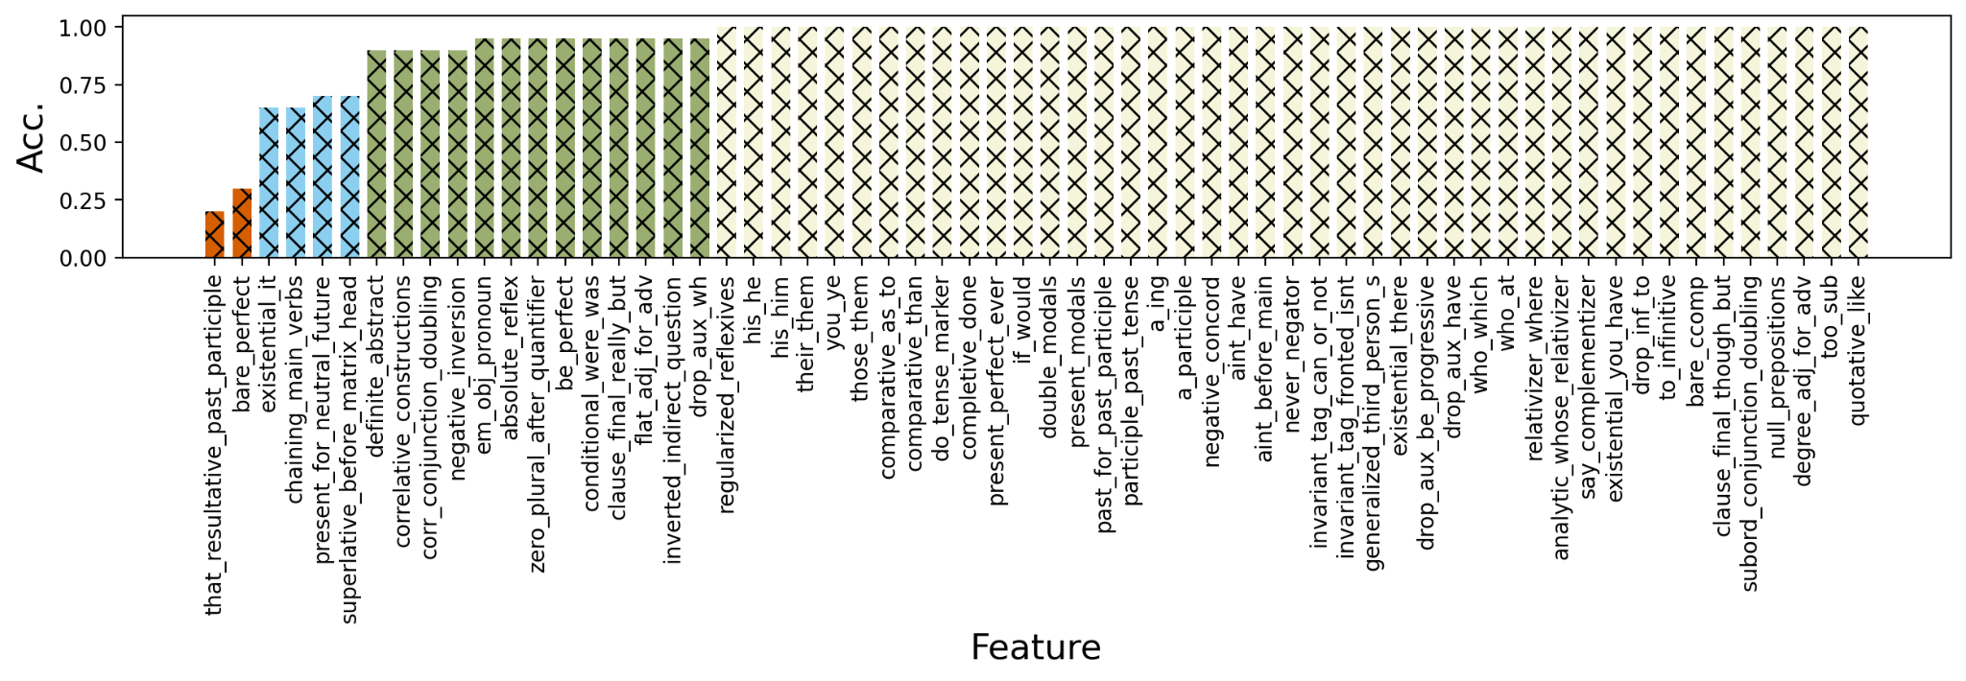

Slide 22
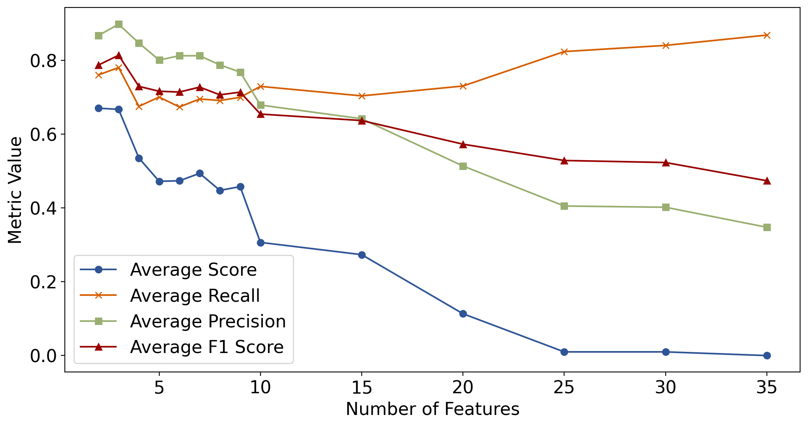
1/ Multiple Choice - Multiple Features
Setup2: ask LLM to identify multiple linguistic features
provide LLM a (synthetic) paragraph with multiple (2-35) linguistic features
🌟 Problem Difficulty Consistently Increases!

Slide 23
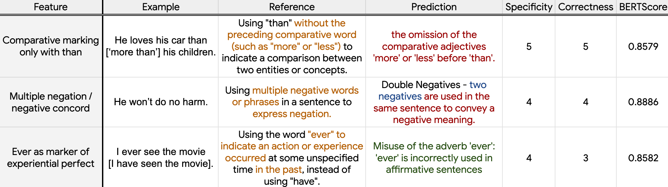
2/ Generation From Scratch
Setup3: ask LLM to output linguistic features from scratch
🌟 Identifying a linguistic feature from scratch is much more difficult than verifying a given one!
🌟 But Iterative Revision and Finetuning Might Help!

Slide 24
Linguistic Feature Auto-Discovery
🌟 More Linguistic Features Possible!

Slide 25
Conclusion
Dynamically aggregation of non-standard linguistic features can better improve LM’s multi-dialectal robustness.
Linguistic feature discovery is hard, but LLMs can help.

Slide 26
Thank You!

